Slide 1

SWS3009
Lecture 2
Deep Learning II
colintan@nus.edu.sg

Slide 2
More Deep Learning Networks
In yesterday’s lecture we looked at several popular deep learning networks:
Recurrent neural networks, including LSTMs.
Transformer networks.
Autoencoders.
Today we continue with more deep learning networks. We will look at:
Generative Adversarial Networks for generating new data.
Convolutional Neural Networks.
Object Detection.

Slide 3
generator adversarial networks
SWS3009 Embedded Systems and Deep Learning.

Slide 4
Generative Adversarial Networks What Are They?
We now look at Generative Adversarial Networks, or GANs.
Motivation:
We often don’t have enough training data.
We want to build a neural network that will produce “fake” data from the real data.
Consists of two networks:
A “Generator” network that learns how to “counterfeit” the data.
Like a forger learning how to make better and better counterfeit money.
A “Discriminator” network that learns how to differentiate between the real and the fake data.
Like a cop learning to differentiate between the increasingly good counterfeit money from the real money.
We can use GANs to do very cool things like:
Producing images of people who don’t exist (!!).

Slide 5

Generative Adversarial Networks What Are They?
The diagram below shows this idea:
Generator:
Random noise is presented to the generator.
The generator uses this to create its fake data.
Discriminator:
Both fake and real data are presented to the discriminator.
Discriminator is trained how to differentiate them.

Slide 6
Generative Adversarial Networks How Do They Work?
Training the Generator:
Weights for the Discriminator are frozen.
The GAN is now trained on the assumption that the fake data is real.
End result: The Generator adjusts its weights to try to maximize the “realness” of the fake data.
The process repeats.
So training alternates between:
Maximizing the Discriminator’s ability to tell fake data from real.
Maximizing the quality of the fake data to minimize the Discriminator’s ability to differentiate.
This is why it is called an “adversarial network”:
The two networks try to fight each other.

Slide 7
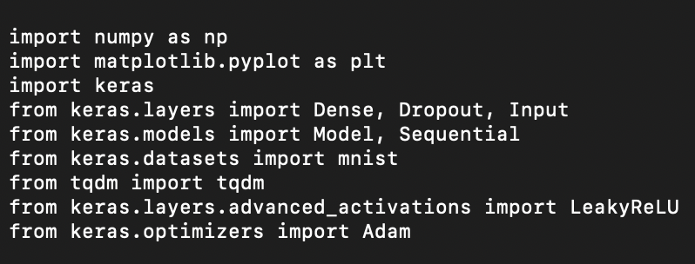
Generative Adversarial Networks Imports
We will now build a GAN to generate fake MNIST data. Create a new file called “gan.py” and key in the following.
As always we begin with the imports:

Slide 8
Generative Adversarial Networks LeakyReLU
Most of this is pretty standard, except for:
Matplotlib: This is a plotting library. Does not work properly on MacOS but we can still use it to generate PNG files.
Tqdm: This is a very cool progress bar library.
We are also importing a new activation function called LeakyReLU

Slide 9
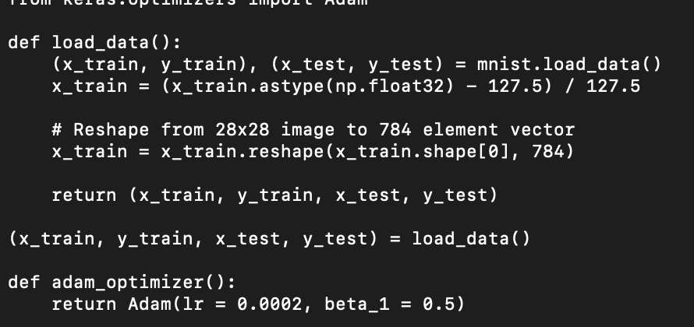
Generative Adversarial Networks Preparing the Data
We load the MNIST data, pretty much the same as before.
Also since we are using the Adam optimizer twice (once each for the Generator and Discriminator), we create a function to create the optimizer.

Slide 10
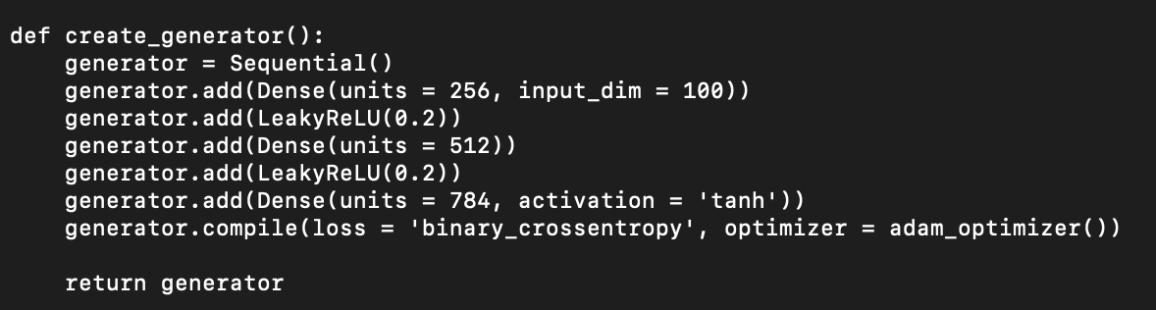
Generative Adversarial Networks Building the Generator
Now we create the Generator network. This is a simple MLP with:
A 100 element input, which will be filled with 100 random numbers.
Two hidden layers.
A 784 element output since our image is 28x28.
Here we use LeakyReLU with a = 0.2, so we have f(x) = 0.2x when x < 0 and f(x) = x when x > 0. f(0) is defined to be 0.

Slide 11
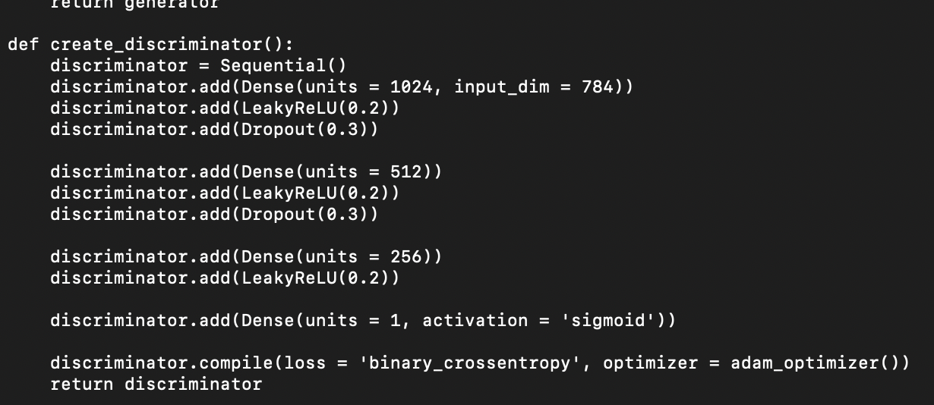
Generative Adversarial Networks Building the Discriminator
We similarly create the Discriminator. It has:
784 inputs, which is our 28x28 real or fake image.
Three hidden layers.
A single output which will be set to either 0 (fake) or 1 (true).

Slide 12
Generative Adversarial Networks Building the GAN
Now we create the GAN. This is relatively simple:
Take as inputs the Generator and Discriminator.
Create an input layer.
Pass the input to the Generator to create the fake image.
Pass this image to the Discriminator.
Set the GAN’s input to the new input layer, and the GAN’s output to the output of the Discriminator.
We use a binary cross-entropy loss since we are doing a binary 0/1 classification.

Slide 13
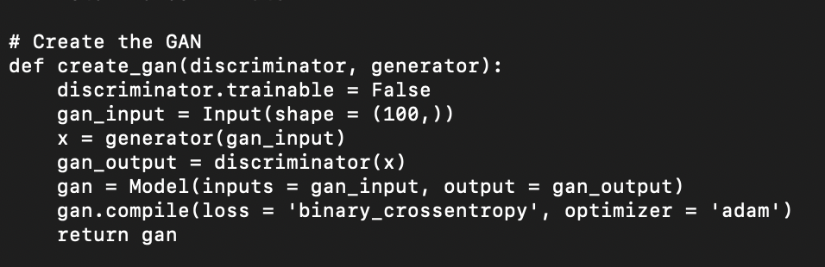
Generative Adversarial Networks Building the GAN

Slide 14
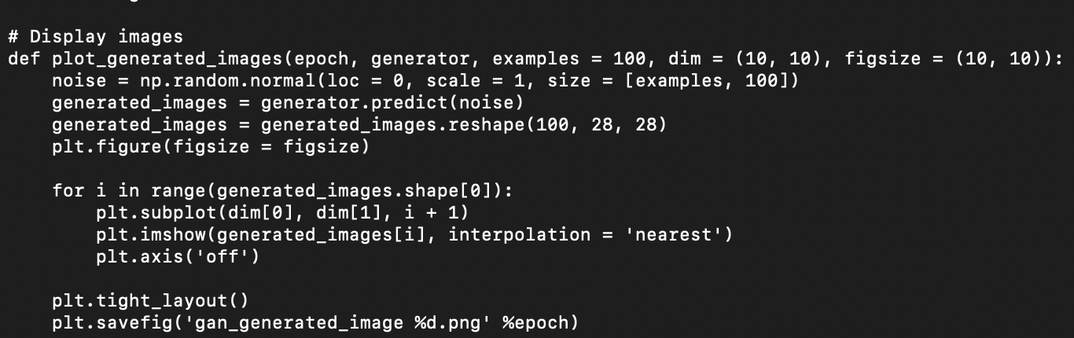
Generative Adversarial Networks Helper Function
Now we create a little helper function just to plot the generated images.

Slide 15
Generative Adversarial Networks Training
Finally we come to the fun part: Training!
Create the Generator, Discriminator and GAN networks, and load the data.
In each epoch, for the Discriminator:
Generate fake data using random numbers.
Randomly choose real data, and combine with fake data,
Tag the real data with “1” and the fake data with ”0”.
Train the Discriminator.
In each epoch, for the Generator:
Freeze the Discriminator’s weights.
Generate the fake data using random numbers.
Train the GAN with the assumption that the fake data is real.
This forces the Generator to optimize its weights to maximize its score from the Discriminator (i.e. “convincing” the Discriminator to output a 1 instead of 0)
The Discriminator itself is not affected since its weights are frozen.

Slide 16
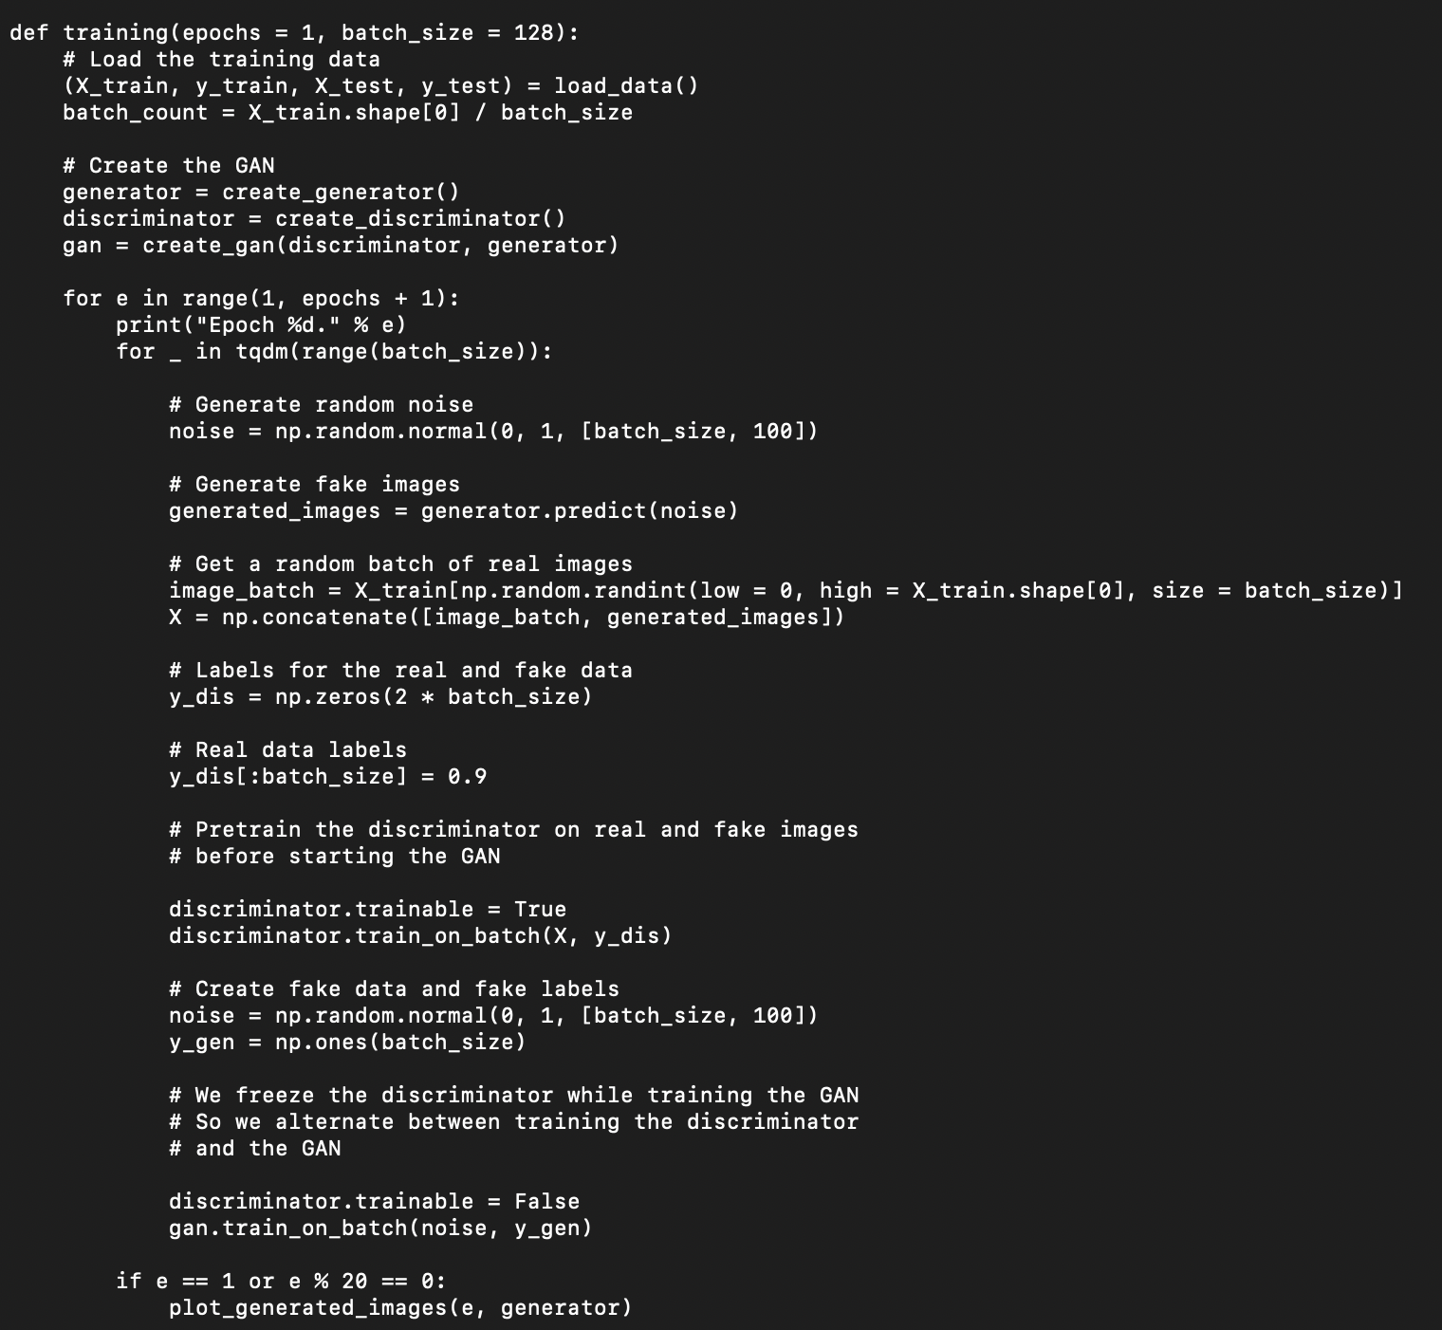

Slide 17
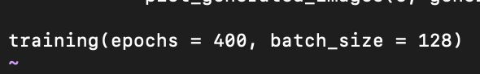
Generative Adversarial Networks
We end with just a single call to train for 400 epochs, with batch size of 128:
When run, the program will display the generated images on the screen (does not work with MacOS) and output to the PNG file with the filename “gan_generated_image xxx.jpg” where xxx is the epoch number.
Next slide shows the results at various epochs.

Slide 18
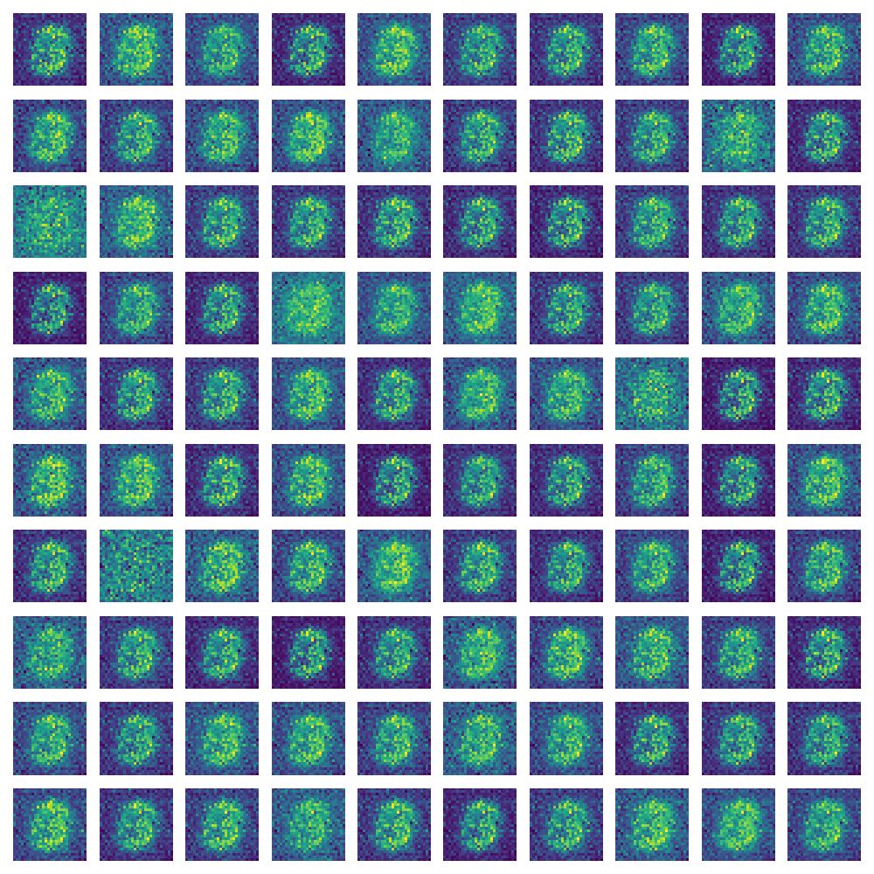
Generative Adversarial Networks Epoch 1

Slide 19
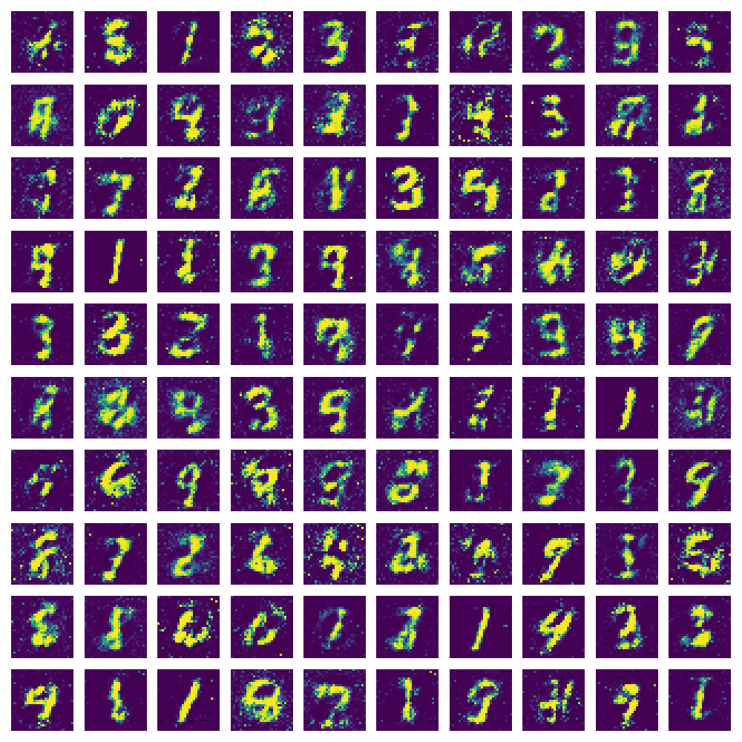
Generative Adversarial Networks Epoch 20

Slide 20
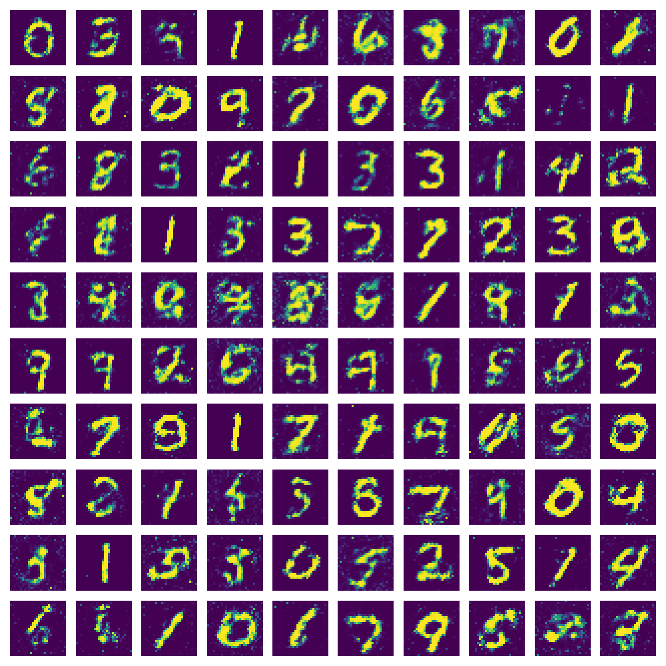
Generative Adversarial Networks Epoch 60

Slide 21
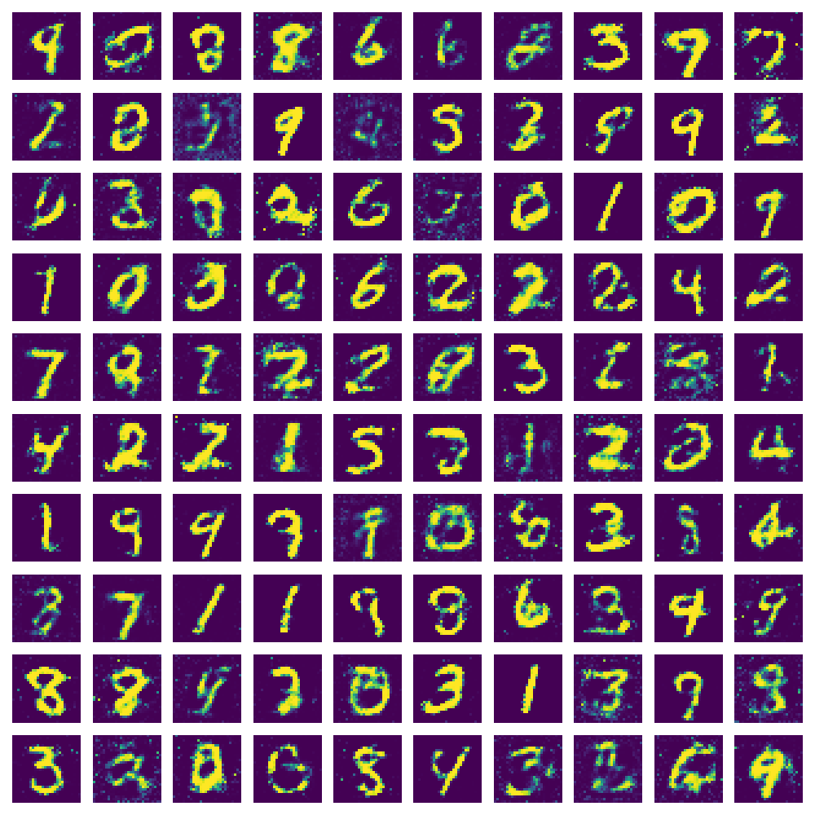
Generative Adversarial Networks Epoch 100

Slide 22
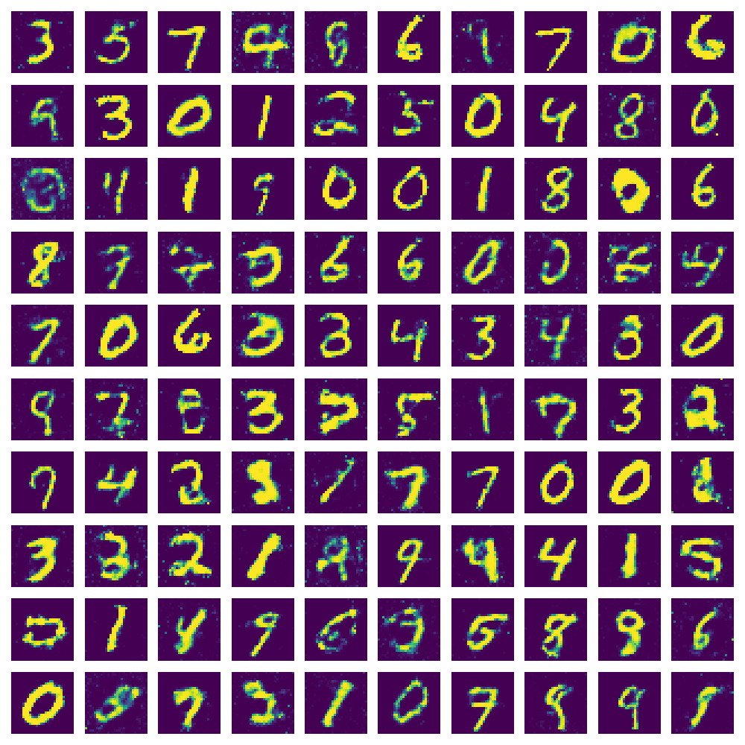
Generative Adversarial Networks Epoch 200

Slide 23
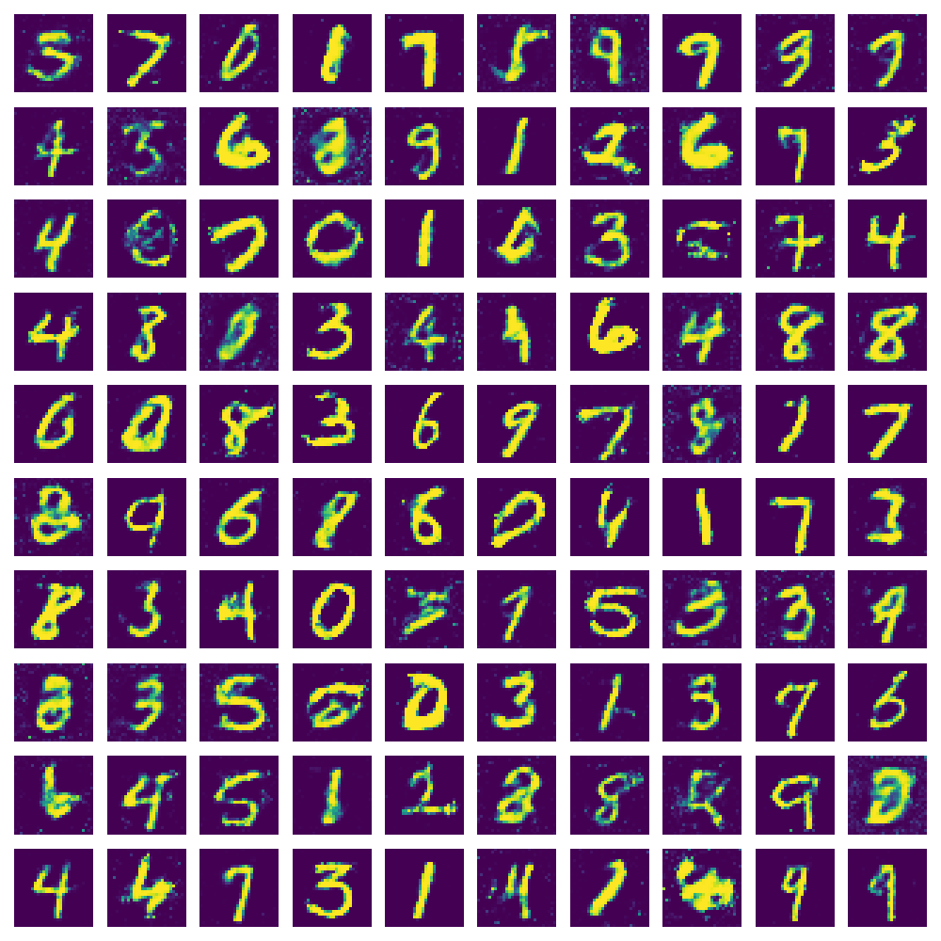
Generative Adversarial Networks Epoch 400

Slide 24
Motivation
In the previous lecture we looked at LSTMs, Autoencoders and Generative-Adversarial Networks, and how to build and use them.
In this lecture we look at:
Convolutional Neural Networks: Traditionally used for image recognition, but can be used elsewhere as well.
An exploration of activations, loss functions and optimizers.
Dealing with Overfitting.
Introductory neural network theory:
Kohonen Self-Organizing Networks
Perceptrons
Multilayer Perceptrons

Slide 25
Convolutional neural networks
SWS3009 Embedded Systems and Deep Learning.

Slide 26
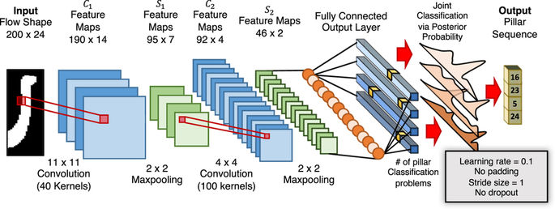
Convolutional Neural Networks Revision: What is a CNN?

Slide 27

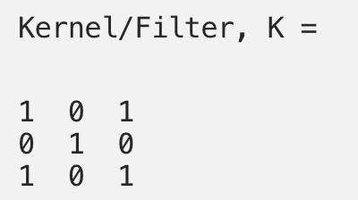
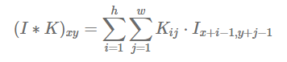
Convolutional Neural Networks Convolution Layers
The CNN’s primary distinguishing feature is the convolution layer.
Made up of kernels that convolve over the input and over each other.

Slide 28

Convolutional Neural Networks Convolution Layers
The depth of the kernel is equal to the depth of the data. E.g. with color images there are 3 channels, and the kernel is 3 layers deep:

Slide 29
Convolutional Neural Networks Convolution Layers
The kernels function as feature extractors and the output from the convolution operation is called a “feature map”
As training progresses the kernels become optimized to extract key information like edges, repeating patterns, etc. in the input data.
Many kernels can be used on one layer.
This will produce a volume of feature maps instead of a single feature map.
Due to the randomness of the initial kernel, each feature map ends up extracting a different feature of the input.

Slide 30
Convolutional Neural Networks Convolution Layers
You can convolve kernels over earlier kernels.
The feature maps generated will represent higher level features of the input.
E.g. the lower kernel might extract lines, the higher kernel might extract shapes.

Slide 31
Convolutional Neural Networks Convolution Layers
Convolution Kernel Hyper-Parameters:
Size:
E.g. 3x3, 5x5, 9x9
Typically smaller kernels extract more refined features at the expense of higher computational costs. Can be more sensitive to noise.
Larger kernels use less computational power but produce features of lower resolution.
Stride:
The # of steps a kernel moves to the right or down each time.
Smaller strides capture more data but also produce larger feature maps.
Larger strides produce smaller feature maps but lose more data.
Padding:
What do we do when we reach the end of the input data and part of the kernel “hangs out” over the edge?
Keras supports a “same” padding that preserves the size of the input. Other choices may increase or decrease the size of the input.

Slide 32
Convolutional Neural Networks Convolution Layers in Keras
Keras offers many types of convolution layers: https://keras.io/layers/convolutional/
padding:
‘valid’: Convolution stops when the right/bottom edge of the filter hits the right/bottom edge of the input data. Will create a feature map smaller than the input
‘same’: Input is padded with ‘0’ to allow the feature map to be the same size as the input.
activation:
If None, Keras will use an identify activation. I.e. id(x) = x, where x is the feature map computed by the convolution operation.
Otherwise can specify other activations like ReLU, tanh etc.
kernel_size:
Size of the kernel window. E.g. (3, 3) makes a 3x3 filter
filters: Number of kernels to make.

Slide 33
Convolutional Neural Networks Pooling Layers
The pooling layer takes a n x n region of the feature map and either picks the maximum or takes an average:
Pooling layers:
Reduce dimensionality and hence computing power.
Extracts the most dominant features (max pooling):
Makes the model shift invariant and less noise sensitive
averages the features (average pooling)
Reduces the effect of noise by averaging it out – white noise has an average of 0.

Slide 34
Convolutional Neural Networks Pooling Layers
Pooling layer hyperparameters:
stride: As with the convolution layer, this determines the number of steps the pool moves each time to the right or down.
size: Controls the dimensionality reduction.
Generally if stride = size, the feature map is reduced by 1/size in each dimension.
Keras pooling API: https://keras.io/layers/pooling/
pool_size: The length or dimensions of the pool.
strides: As described above.
Generally the first few (or many?) layers of the CNN consist of alternating convolution and pooling layers:
However stacking too many pooling layers can result in losing all data.

Slide 35
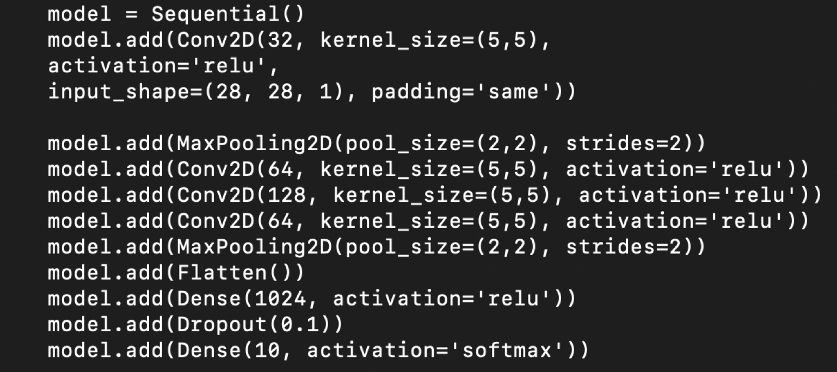
Convolutional Neural Networks Flatten Layer / Example
The Flatten layer turns the feature maps into a 1D vector for feeding into the Dense layers.
Example:

Slide 36
object detection
SWS3009 Embedded Systems and Deep Learning.

Slide 37
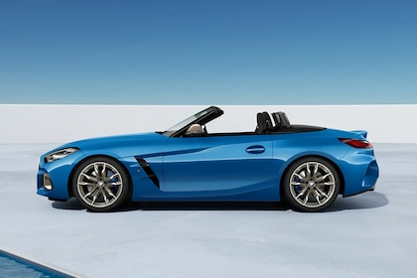
Object Detection
The CNNs we saw earlier are very good at recognizing single objects in pictures like this – the object is large and relatively isolated.

Slide 38
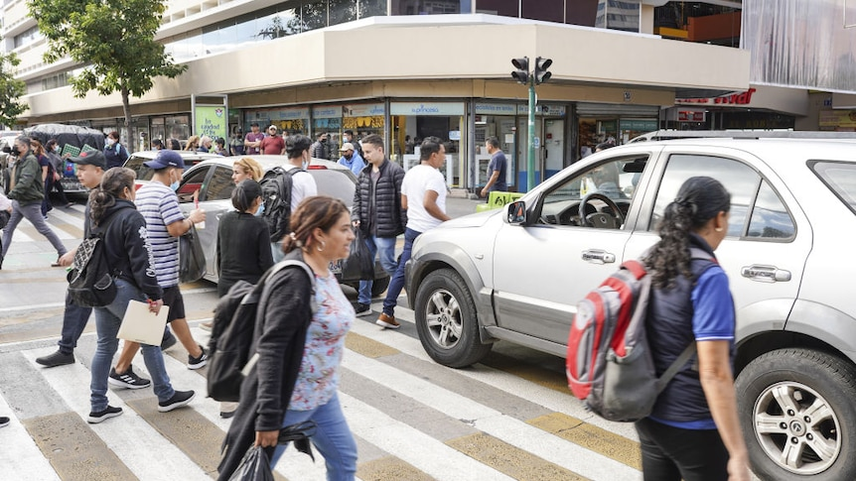
Object Detection
However it doesn’t perform as well in pictures like this, where there are many objects:

Slide 39
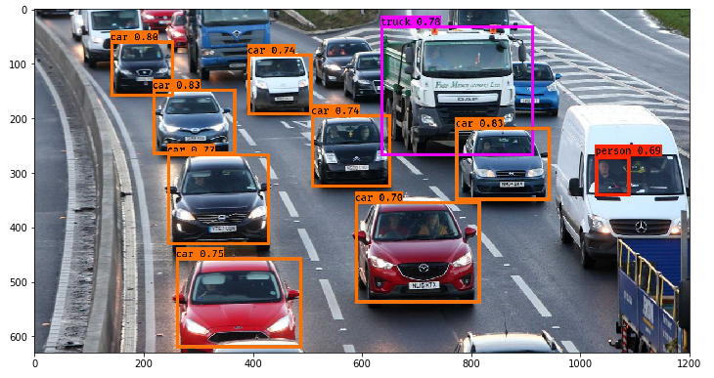
Object Detection
We very often also want to locate and identify many objects at once, e.g. when building autonomous vehicles:

Slide 40
Object Detection
There are several ways to solve this problem. One popular way:
Pre-train a classifier (e.g. CNN) to recognize various objects.
Divide up the image into multiple regions.
Perform classification in each region.
Many object detection algorithms follow this method:
Regions with CNN Features (RCNN)
Fast RCNN, Faster RCNN
Single-Shot Detector (SSD)
In the following sections we assume that the input to each network is an image with multiple objects to be ”localized” and “classified”.
“Localized” – Where is the object?
“Classified” – What is the object?
For training, each object is assumed to have a bounding box called “GT” – short for “Ground Truth”

Slide 41
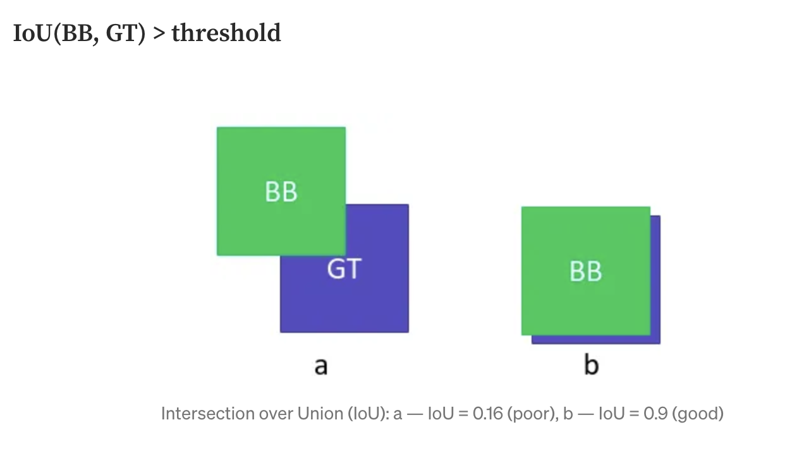
Object Detection
Localization goodness-of-fit metric: Intersection over Union (IoU)
We measure how well the algorithm’s bounding box (BB) for each object overlaps with GT:

Slide 42
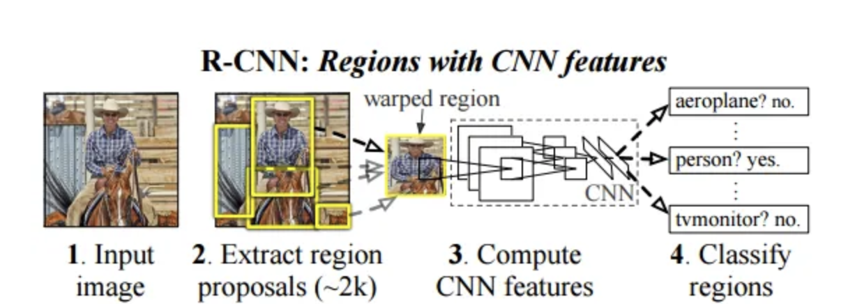
Object Detection – RCNN
In RCNN:
A fixed (non-trainable) algorithm scans the image for possible objects:
Creates proposed bounding boxes for each region that the algorithm thinks there is an object.
Returns bounding boxes with high object scores as “Regions of Interest” or ROIs.
A feature extractor (convolution/pooling layers of an image classifier) then generates classification information for each ROI
A CNN (“classification head”) uses this information to classify objects in each ROI.

Slide 43
Object Detection – Fast RCNN
RCNN is very slow:
Many overlapping ROIs generated for each image, resulting in many passes through the feature extractor and classifier.
Each image took 47 seconds to process.
Fast RCNN:
Similar to RCNN, except that the output of the feature extractor goes to a classification head and a box regression head.
The regression head predicts the size and centre of the object, to reduce the number of ROIs to be processed.
150x speed improvement over RCNN.
Faster RCNN:

Slide 44
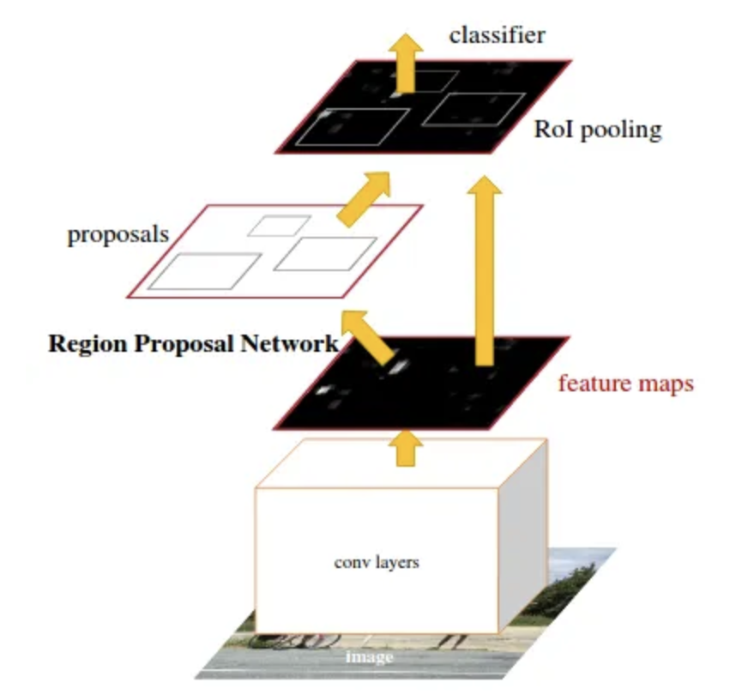
Object Detection – Faster RCNN
Faster RCNN
ROI proposal module is eliminated, entire image and not just ROIs are fed to the feature extractor.
Box regression head replaced with a region proposal network (RPN):
Trained to generate region proposals and object scores.
An algorithm then loops through the proposed regions and picks the best.

Slide 45
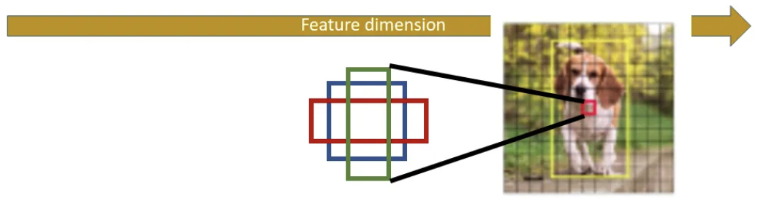
Proposing Bounding Boxes
Each output of the RPN is given a set of bounding boxes in different heights and widths - “Anchors”
The network then learns how to select and transform the anchor to best capture the object.
”Non-maximal suppression” (NMS) is then performed:
IoU for pairs of bounding boxes is performed.
If there is a pair with very high IoU we assume that they bound the same object - the bounding box with the lower confidence score is discarded
Expensive: O(n²)

Slide 46
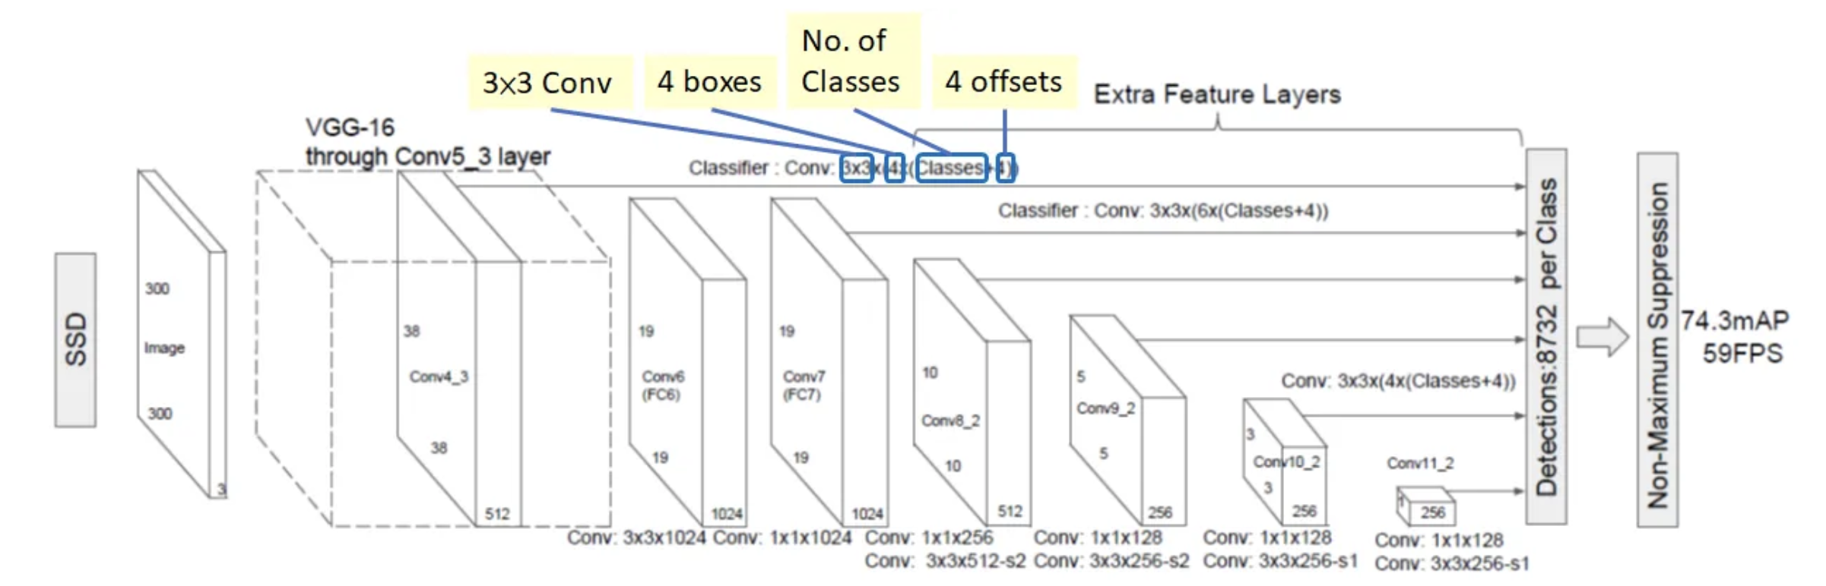
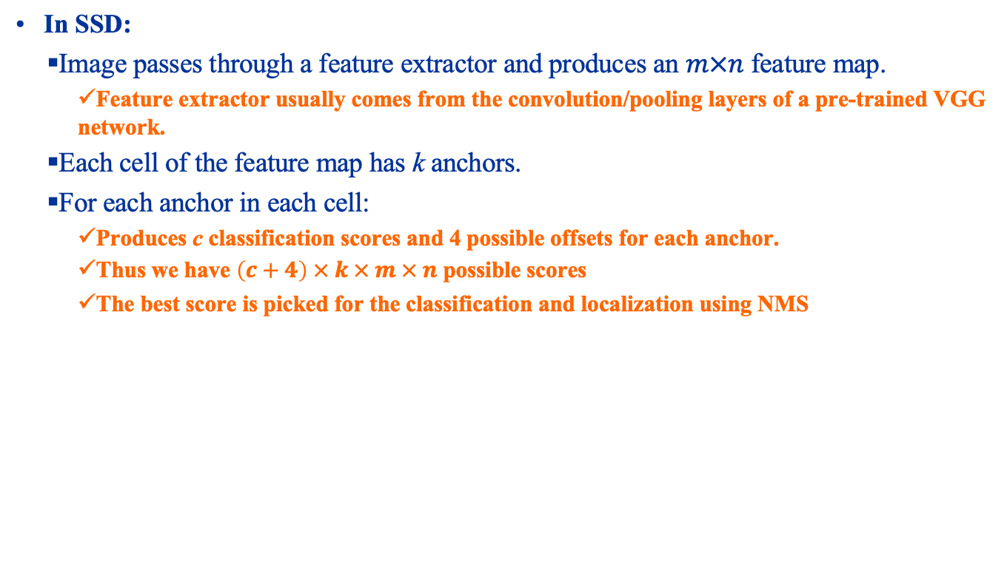
Object Detection – Single Shot Detector (SSD)
In SSD:
Image passes through a feature extractor and produces an $m×n$ feature map.
Feature extractor usually comes from the convolution/pooling layers of a pre-trained VGG network.
Each cell of the feature map has k anchors.
For each anchor in each cell:
Produces c classification scores and 4 possible offsets for each anchor.
Thus we have $\left(c+4\right) × k × m × n$ possible scores
The best score is picked for the classification and localization using NMS

Slide 47
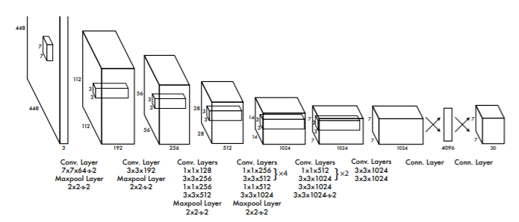
Object Detection – You Only Look Once (YOLO)
The YOLO algorithm uses a single CNN to generate classification and localization data for each object:
20 layers of convolutions, Average Pooling and dense layer trained on ImageNet dataset.
4 convolution and 2 dense networks added for classification.
Final layer produces classification and bounding box scores.
Non-maximal suppression removes redundant boxes with large overlaps.
Very fast object detection with high accuracy – Considered state of the art.

Slide 48
Object Detection – You Only Look Once (YOLO)
There are no standard YOLO libraries implemented in Keras:
You are provided with several Python scripts that contain a YOLO implementation.
Complex, will not be covered here.

Slide 49
Summary
Over the past few lectures we have looked at various methods of machine learning:
Neural Networks: Slow learning, potentially very powerful, can learn very complex patterns. Can be prone to overfitting due to high density of the parameters.
Deep Networks: Very large complex networks, but made up of many often heterogeneous types of networks that try to simplify the inputs, so that we can use a relatively small dense network to perform final decisions.
In the next lecture we will look at statistical methods:
Fast, based on sound statistical and information theory. May not handle scale and complexity well.
We’ve also seen how these have been applied to solve various problems.
Think about what sort of problem you’d like to solve for your project.
Think about the kind of machine learning architectures.
Start collecting potentially relevant data (from places like Kaggle) and experiment.

